Slide 1
Wireless Asynchronous Transfer Mode (ATM)

Slide 2
Asynchronous Transfer Mode (ATM)
Asynchronous Transfer Mode (ATM) is a switching technique that uses time division multiplexing (TDM) for data communications.
It is a network technology that supports voice, video and data communications.
There are two fundamental types of ATM connections:
Permanent Virtual Connections (PVC):A PVC is a connection set up by some external mechanism, typically network management, in which a set of switches between an ATM source and destination ATM systems are programmed with the appropriate VPI/VCI values. PVCs always require some manual configuration.
Switched Virtual Connections (SVC):An SVC is a connection that is set up automatically through signalling protocol. SVCs does not require the manual interaction needed to set up PVCs and, as such, are likely to be much more widely used. All higher layer protocols operatring over ATM primarily uses SVCs.
ATM is a form of cell switching using small fixed-sized packets.

Slide 3
ATM Services
The services provided by ATM are as follows−
Available Bit Rate: It provides a guaranteed minimum capacity, but data can be burst to higher capacities when network traffic is lower.
Constant Bit Rate: It is used to specify a fixed bit rate so that data is sent in a steady stream. This is analogous to a leased line.
Unspecified Bit Rate: This doesn't assure any throughput level and is used for applications, including file share that can tolerate delays.
Variable Bit Rate (VBR): It can provide a determining throughput, but data is not transmitted evenly. This makes it a famous choice for voice and video conferencing.

Slide 4
Benefits of ATM
Dynamic bandwidth for bursty traffic meeting application needs and delivering high utilization of networking resources; most applications are or can be viewed as inherently bursty, for example voice is bursty, as both parties are neither speaking at once nor all the time; video is bursty, as the amount of motion and required resolution varies over time.
Smaller header with respect to the data to make the efficient use of bandwidth.
Can handle Mixed network traffic very efficiently: Variety of packet sizes makes traffic unpredictable. All network equipments should incorporate elaborate software systems to manage the various sizes of packets. ATM handles these problems efficiently with the fixed size cell.
Cell network: All data is loaded into identical cells that can be transmitted with complete predictability and uniformity.
Class-of-service support for multimedia traffic allowing applications with varying throughput and latency requirements to be met on a single network.
Scalability in speed and network size supporting link speeds of T1/E1 to OC–12 (622 Mbps).
Common LAN/WAN architecture allowing ATM to be used consistently from one desktop to another; traditionally, LAN and WAN technologies have been very different, with implications for performance and interoperability. But ATM technology can be used either as a LAN technology or a WAN technology.
International standards compliance in central-office and customer-premises environments allowing for multivendor operation.

Slide 5
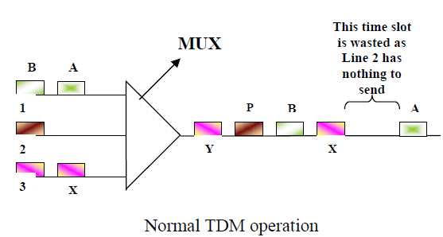
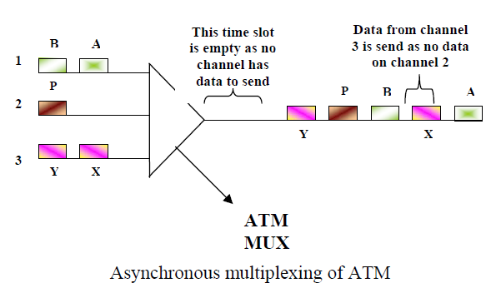
Why Wireless ATM…..?
Since the beginning, the concept of ATM is end-to-end communications i.e. in a Wide Area Network environment, the communication protocol will be the same i.e. ATM, and companies will no longer have to buy extra equipment ( like routers or gateways) to interconnect their LANs ( local area networks).
Also, ATM is considered to reduce the complexity of the network and improve the flexibility while providing end-end consideration of traffic performance.
seamless integration of mobility into B-ISDN (Broadband Integrated Services Digital Network).
An integrated services high performance network supporting different types a traffic streams.

Slide 6
Wireless ATM
The combination of wireless communications and ATM, referred to as “wireless ATM”, aims at providing freedom of mobility with service advantages and QoS guarantees.
Wireless ATM (WATM) is a direct result of the ATM "everywhere" movement.
WATM can be viewed as a solution for next-generation personal communication networks, or a wireless extension of the B-ISDN (Broadband Integrated Services Digital Network) networks, which will support integrated data transmission (data, voice, video) with guaranteed QoS.

Slide 7
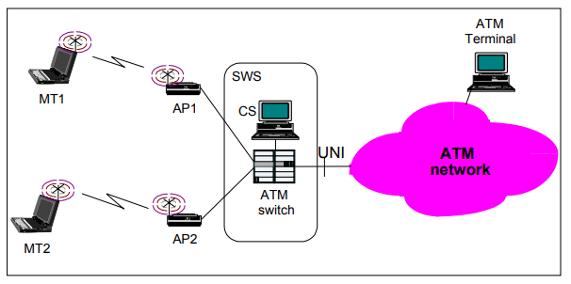
Contd.
Wireless ATM is mainly considered for wireless access to a fixed ATM network; in this sense, it is mostly applicable to wireless LANs. A typical wireless ATM network (Figure 1) includes the following main components:
Mobile Terminals (MTs), the end user equipment, which are basically ATM terminals with a radio adapter card for the air interface,
Access Points (APs), the base stations of the cellular environment, which the MTs access to connect to the rest of the network,
an ATM Switch (SW), to support interconnection with the rest of the ATM network, and
Control Station (CS), attached to the ATM switch, containing mobility specific software, to support mobility related operations, such as handover, which are not supported by the ATM switch.
Figure 1: A typical wireless ATM network

Slide 8
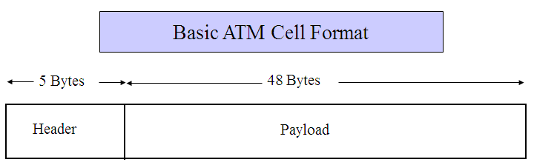
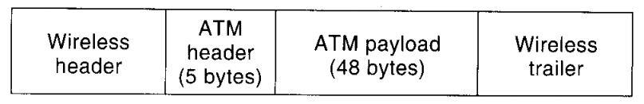
Contd.
ATM is a form of cell switching using small fixed-sized packets.
The size of an ATM cell is 53 bytes, 5 byte header and 48 byte payload. There are two different cell formats − user-network interface (UNI) and network-network interface (NNI).
Basic WATM Cell Format

Slide 9
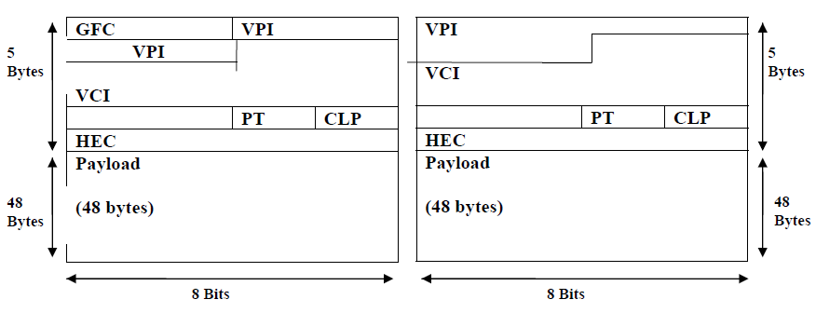
ATM Cell formats
UNI Cell format
NNI Cell format

Slide 10
ATM Cell Header Fields
Generic Flow Control (GFC)—Provides local functions, such as identifying multiple stations that share a single ATM interface. This field is typically not used and is set to its default value of 0 (binary 0000).
Virtual Path Identifier (VPI)—In conjunction with the VCI, identifies the next destination of a cell as it passes through a series of ATM switches on the way to its destination.
Virtual Channel Identifier (VCI)—In conjunction with the VPI, identifies the next destination of a cell as it passes through a series of ATM switches on the way to its destination.
Payload Type (PT)—Indicates in the first bit whether the cell contains user data or control data. If the cell contains user data, the bit is set to 0. If it contains control data, it is set to 1. The second bit indicates congestion (0 = no congestion, 1 = congestion), and the third bit indicates whether the cell is the last in a series of cells that represent a single AAL5 frame (1 = last cell for the frame).
Cell Loss Priority (CLP)—Indicates whether the cell should be discarded if it encounters extreme congestion as it moves through the network. If the CLP bit equals 1, the cell should be discarded in preference to cells with the CLP bit equal to 0.
Header Error Control (HEC)—Calculates checksum only on the first 4 bytes of the header. HEC can correct a single bit error in these bytes, thereby preserving the cell rather than discarding it.

Slide 11
ATM Connections
ATM will be connection-oriented.
A connection (an ATM channel) must be established before any cells are sent.
There are two levels of ATM connections:
virtual path connections
virtual channel connections
The connections are indicated by two fields in the cell header:
virtual path identifier (VPI)
virtual channel identifier (VCI)

Slide 12
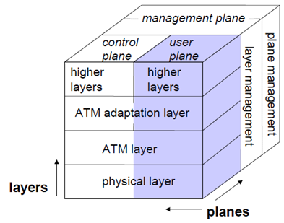
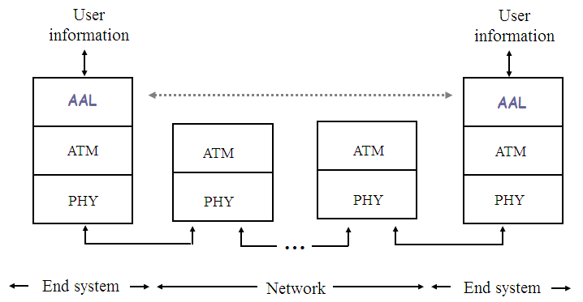
ATM Reference Model
ATM 3 dimensional reference model comprises of three layers.
Three vertical planes (columns)
User plane
Control plane
Management plane
Three hierarchical layers
Physical layer
Atm layer
Atm adaptation layer

Slide 13
Physical Layer
This layer corresponds to physical layer of OSI model. At this layer the cells are converted into bit streams and transmitted over the physical medium.
This layer has two sub layers − PMD sub layer (Physical Medium Dependent) and TC sub layer (Transmission Convergence) sub layer.
The main functions are as follows:
It converts cells into a bit stream.
It controls the transmission and receipt of bits in the physical medium.
The physical medium sublayer defines the exact electrical and optical interface, the line code and the bit timing.
The TC sublayer provides for framing of cells, for cell rate adaption to the information carriage capacity of the line, and for operational monitoring of the various line components.

Slide 14
ATM Layer
This layer is comparable to data link layer of OSI model.
It handles transmission, switching, congestion control, cell header processing, sequential delivery, etc.. It is the ATM layer which controls the transport of cells across an ATM network, setting up virtual channel connections and controlling the submission rate (generic flow control) of cells from user equipment.
It is also responsible for simultaneously sharing the virtual circuits over the physical link known as cell multiplexing and passing cells through ATM network known as cell relay making use of the VPI and VCI information in the cell header.
It accepts the 48 byte segments from the upper layer, adds a 5 byte header to each segment and converts into 53 byte cells. This layer is responsible for routing of each cell, traffic management, multiplexing and switching.

Slide 15
ATM Adaptation Layer (AAL)
This layer corresponds to network layer of OSI model. It provides facilities to the existing packet switched networks to connect to ATM network and use its services.
It allows different types of information to be adapted for carriage across a common ATM transport network.
It is meant for isolating higher layer protocols from details of ATM processes and prepares for conversion of user data into cells and segments it into 48-byte cell payloads.
The transmissions can be of fixed or variable data rate.
This layer has two sub layers − Convergence sub layer (where the alignment of the various information types into a common format takes place and division into cells occurs) and Segmentation and Reassembly sub layer (where the cells are numbered sequentially to allow reconstruction in the right order at the receiving end).

Slide 16
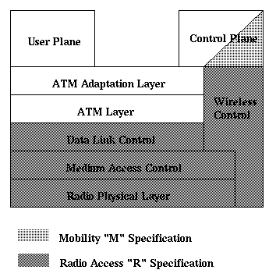
Wireless ATM Protocol Architecture
The WATM items are divided into two distinct parts:
Mobile ATM (Control Plane, as showed in Figure), and
Radio Access Layer (Wireless Control, as showed in Figure).
Mobile ATM
Mobile ATM is dealing with the higher-layer control/signaling functions needed to support mobility.
These control/signaling include handover, location management, routing, addressing, and traffic management.
Radio Access Layer
Radio Access Layer is responsible for the radio link protocols for wireless ATM access. Radio Access Layers consists of PHY (Physical Layer), MAC (Media Access Layer), DLC (Data Link Layer), and RRC (Radio Resource Control). Up to now, only PHY and MAC are under consideration. The protocols and approaches for DLC and RRC have not been proposed yet.
[WATM Protocol Architecture]

Slide 17
Radio Access Layer
WATM MAC is responsible for providing functionally point to point links for the higher protocol layer to use.
DLC is responsible for providing service to ATM layer.
Mitigating the effect of radio channel errors should be done in this layer before cells are sent to the ATM layer.
RRC is needed for support of control plane functions related to the radio access layer. It should support radio resource control and management functions for PHY, MAC, and DLC layers.

Slide 18
Mobile ATM
In WATM networks, a mobile end user establish a virtual circuit (VC) to communicate with another end user (either mobile or ATM end user).
When the mobile end user moves from one AP (access point) to another AP, proper handover is required.
To minimize the interruption to cell transport, an efficient switching of the active VCs from the old data path to new data path is needed. Also the switching should be fast enough to make the new VCs available to the mobile users.
When a connection is needed to be established between an mobile ATM end point and another ATM end point, the mobile ATM end point is needed to be located.
There are two basic location management schemes: the mobile PNNI scheme and the location register scheme.
Due to the mobility feature of mobile ATM, routing signaling is a little bit different from that for the wired ATM network.
First, mapping of mobile terminal routing-id's to paths in the network is necessary. Also rerouting is needed to re-establish connection when the mobiles move around.

Slide 19
Contd.
Addressing issue of WATM focuses on the addressing of the mobile terminal (or mobile end user device).
The current solution is that each mobile terminal has a name and an local address. The name of the mobile terminal is a regular ATM end system address.
The mobility feature puts additional impact on traffic control and QoS control.
In wireless networks, the topology is changing in time. This, as well as other mobility feature, present a unique set of network management challenges.
A specific methods must be designed to maintain the dynamic nature of the network topology.

Slide 20
The End

